Slide 1

A Project Review Meeting on Doctor Appointment Booking System
By
Name B.Siddhartha roll 2500090225
Name C.V.JaswanthReddy roll 2520080025
Team Number: 20
Under the guidance of
Ms.D.Pavithra
Assistant Professor
Department of Computer Science and Engineering
Koneru Lakshmaiah Education Foundation (Deemed to be University estd. u/s. 3 of the UGC Act, 1956) Off-Campus: Bachupally-Gandimaisamma Road, Bowrampet, Hyderabad, Telangana - 500 043. Phone No: 7815926816, www.klh.edu.in

Slide 2
Outline of the Presentation
Abstract
Introduction
Problem Statement
Project Flow Diagram
Objectives with Justification
Modules[Frontend web pages]
Expected Outcomes of the Proposed Work
Conclusion
References

Slide 3
Abstract
The Doctor Appointment Booking System with Smart Queue Management is a web-based application that allows patients to register, log in, select doctors based on specialization, and book appointments online. The system provides a unique token number for each appointment and displays real-time queue status along with estimated waiting time.
It also includes notification alerts to inform patients when their turn is approaching, reducing waiting time and improving hospital efficiency. Developed using React.js, the system offers a simple, user-friendly, and efficient solution for modern healthcare appointment management.

Slide 4
Introduction
The Doctor Appointment Booking System with Smart Queue Management is a web-based application designed to simplify the process of scheduling medical appointments. It allows patients to register, log in, select doctors based on specialization, choose hospitals, and book appointments online.
The system includes a Smart Queue feature that assigns token numbers, displays real-time queue status, estimates waiting time, and sends notifications when a patient's turn is approaching. This helps reduce waiting time, improve patient convenience, and enhance hospital efficiency.
Developed using React.js, the system provides a user-friendly and modern solution for managing doctor appointments digitally while improving the overall healthcare experience.

Slide 5
Problem Statement
Traditional hospital appointment systems often rely on manual booking procedures, resulting in long waiting times, overcrowding, and inefficient patient management. Patients frequently face difficulties in scheduling appointments, tracking their turn, and estimating waiting times. Lack of real-time updates can lead to inconvenience and missed appointments.
The Doctor Appointment Booking System with Smart Queue Management aims to solve these issues by providing an online platform for appointment booking, real-time queue tracking, token-based scheduling, and notification alerts. The system improves patient convenience, reduces waiting time, and enhances the overall efficiency of healthcare services.

Slide 6
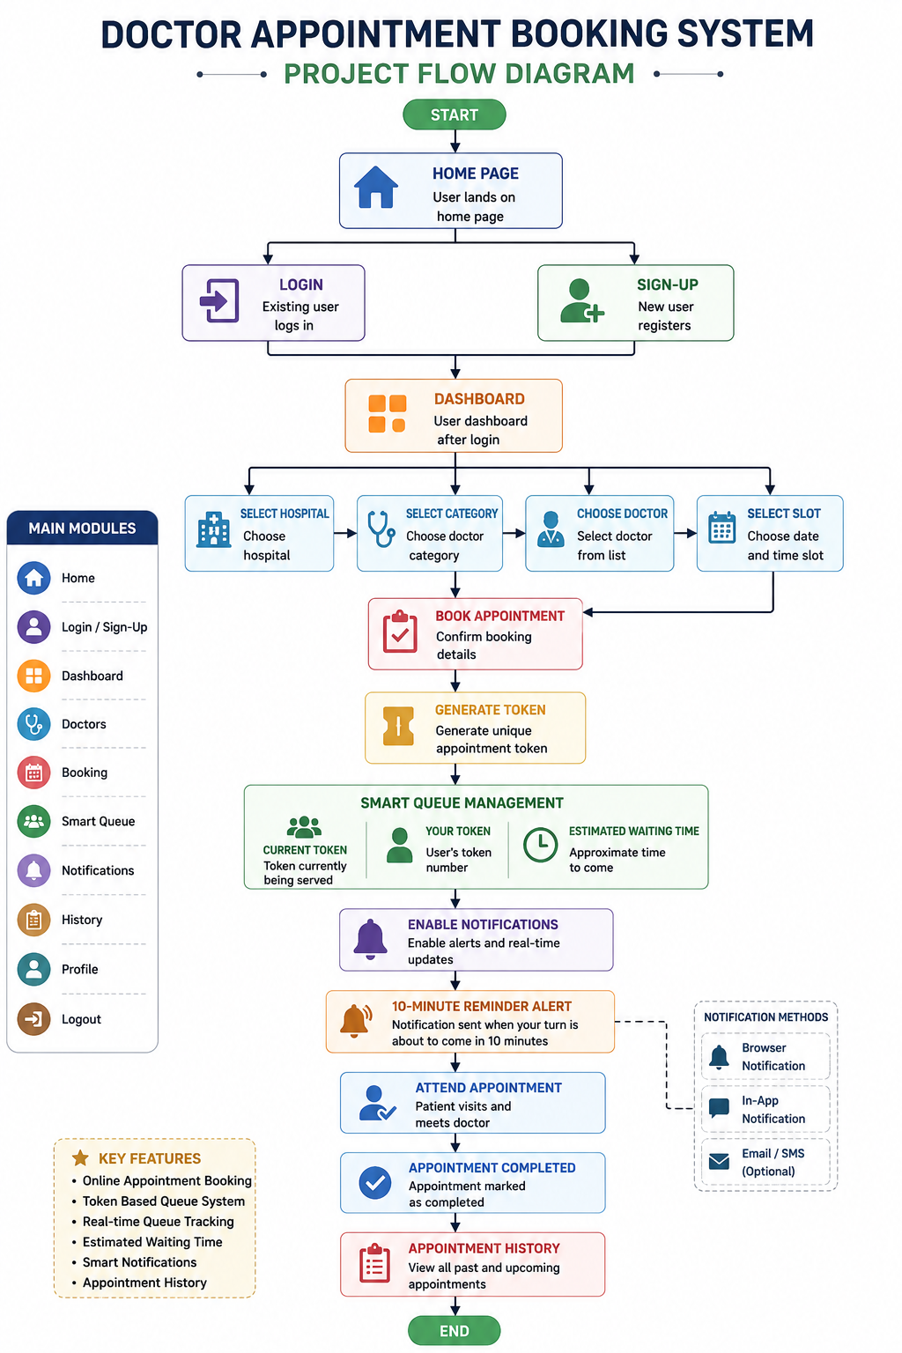
Project Flow Diagram

Slide 7
Objectives with Justification
Objective 1: Simplify Appointment Booking
Justification: Traditional appointment booking methods require patients to visit hospitals or make phone calls, which is time-consuming. The system allows patients to book appointments online quickly and conveniently.
Objective 2: Reduce Patient Waiting Time
Justification: Long waiting times are a common problem in hospitals. By providing estimated waiting times and token-based queue management, patients can plan their visit more efficiently.
Objective 3: Implement Smart Queue Management
Justification: The smart queue system assigns token numbers and tracks the current queue status. This helps hospitals manage patient flow effectively and reduces overcrowding.
Objective 4: Provide Real-Time Notifications
Justification: Patients often miss their appointments due to lack of updates. Notification alerts inform users when their turn is approaching, improving punctuality and reducing missed appointments.

Slide 8
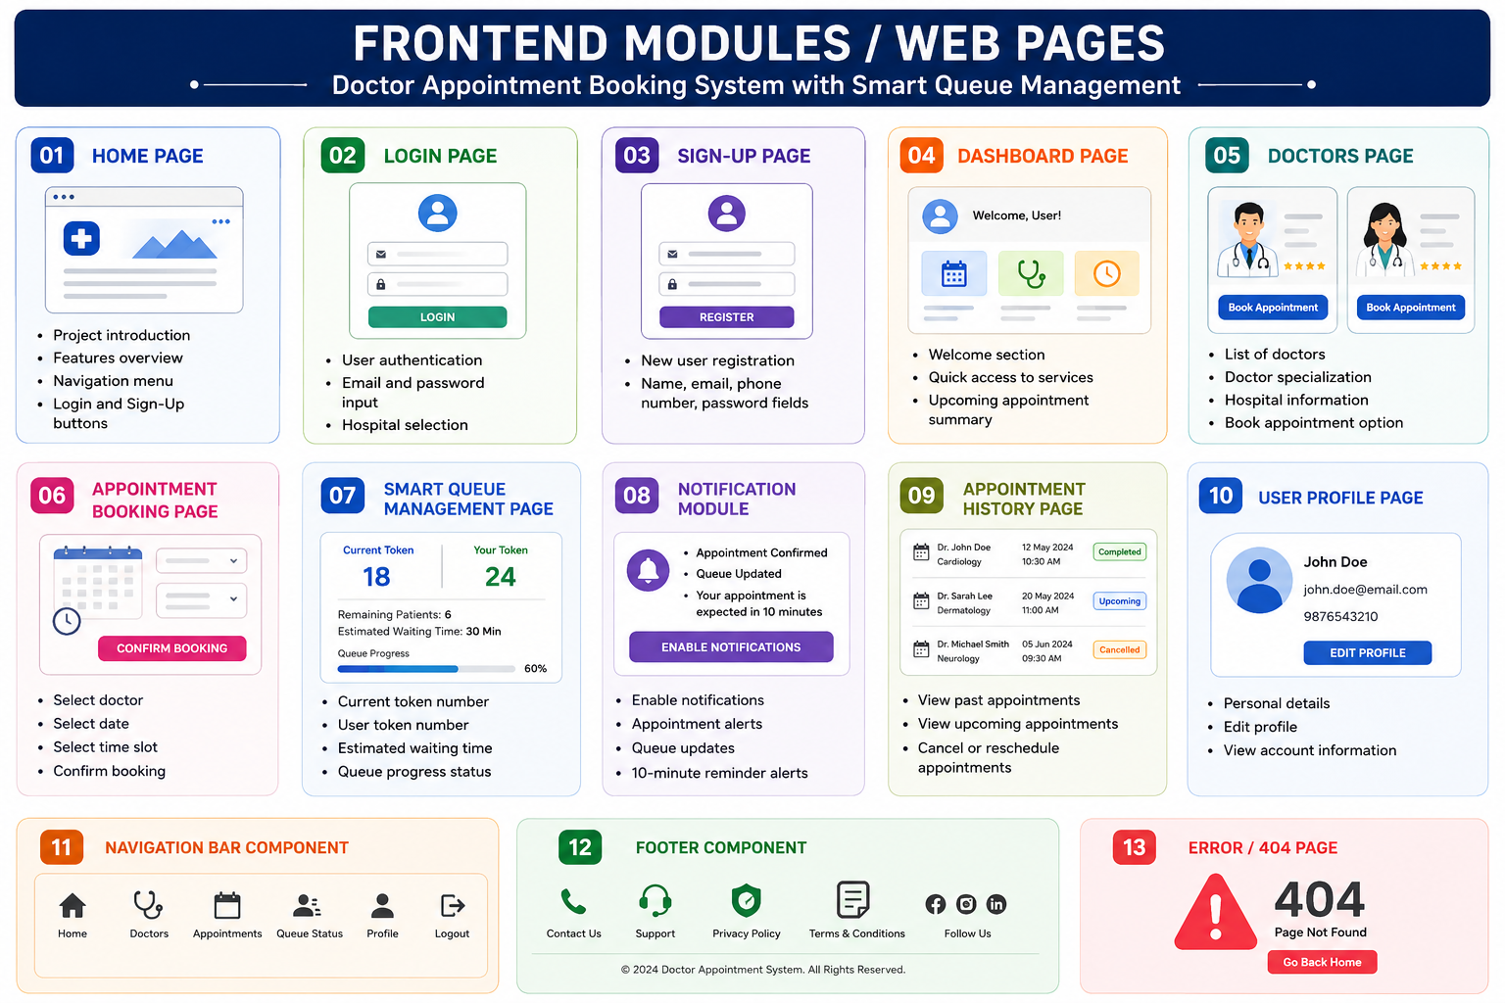
Modules [Frontend web pages]

Slide 9
Expected Outcomes of the Proposed Work
• Online Appointment Booking
• Smart Queue Management
• Reduced Waiting Time
• Real-Time Queue Tracking
• Notification Alerts
• Improved Patient Experience
• Better Hospital Resource Utilization
• Digital Record Management
• Enhanced Healthcare Accessibility
• Efficient and Modern Healthcare Service

Slide 10
Conclusion and Future Scope
Conclusion:
Simplifies doctor appointment booking.
Reduces waiting time through smart queue management.
Provides real-time tracking and notifications.
Improves patient experience and hospital efficiency.
Future Scope:
Video consultations
AI doctor recommendations
Mobile app development
Online payments
SMS/Email notifications
Emergency priority system
Cloud deployment
Multi-language support

Slide 11
References
React.js Official Documentation - https://react.dev/
[2] React Router Documentation - https://reactrouter.com/
[3] MDN Web Docs - https://developer.mozilla.org/
[4] W3Schools Tutorials - https://www.w3schools.com/
[5] Notifications API Documentation - https://developer.mozilla.org/en-US/docs/Web/API/Notifications_API
[6] Bootstrap Documentation - https://getbootstrap.com/
[7] GitHub Documentation - https://docs.github.com/
[8] Queue Management System Concepts - https://www.sciencedirect.com/topics/computer-science/queue-management

Slide 12
CO’S MAPPING
CO’S: | Topics Covered in Project:
CO1 | React Components, JSX, Component-Based Architecture
CO2 | JavaScript ES6+, Event Handling, Form Validation
CO3 | Functional Components, Props, useState, useEffect
CO4 | State Management, Queue Tracking, Notifications
CO5 | React Router, Forms, Validation, Responsive UI
CO6 | React Build Tools, npm, GitHub Deployment

Slide 13
Thank you

